Slide 1
Backtracking
By: Ashok Basnet

Slide 2
Lecture Outline
Introduction to Backtracking method of problem solving
The 8-queen problem
Sum of Sub-set problem
Graph coloring problem
Hamilton Cycle

Slide 3
Introduction to Backtracking method of problem solving
Backtracking is used to solve problem in which a sequence of objects is chosen from a specified set so that the sequence satisfies some criterion.
Backtracking is a modified depth first search of a tree.
Backtracking algorithms determine problem solutions by systematically searching the solution space for the given problem instance.
This search is facilitated by using a tree organization for the solution space.
Backtracking is the procedure where by, after determining that a node can lead to nothing but dead end, we go back (backtrack) to the nodes parent and proceed with the search on the next child.

Slide 4
Terminology
Problem state is each node in the depth first search tree.
Solution states are the problem states ‘S’ for which the path from the root node to ‘S’ defines a tuple in the solution space.
Answer states are those solution states for which the path from root node to s defines a tuple that is a member of the set of solutions.
State space is the set of paths from root node to other nodes. State space tree is the tree organization of the solution space.
Live node is a node that has been generated but whose children have not yet been generated.
E-node is a live node whose children are currently being explored. In other words, an E-node is a node currently being expanded.
Dead node is a generated node that is not to be expanded or explored any further. All children of a dead node have already been expanded.

Slide 5
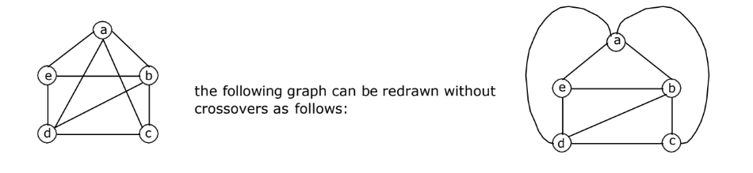
Planar Graphs
When drawing a graph on a piece of a paper, we often find it convenient to permit edges to intersect at points other than at vertices of the graph.
These points of interactions are called crossovers.
A graph G is said to be planar if it can be drawn on a plane without any crossovers; otherwise G is said to be non-planar i.e., A graph is said to be planar.

Slide 6
N-Queens Problem
Let us consider, N = 8. Then 8-Queens Problem is to place eight queens on an 8 x 8 chessboard so that no two “attack”, that is, no two of them are on the same row, column, or diagonal.
All solutions to the 8-queens problem can be represented as 8-tuples (x1, . . . . , x8), where x^{i} is the column of the i^{th} row where the i^{th} queen is placed.
The explicit constraints using this formulation are S_{i} = {1, 2, 3, 4, 5, 6, 7, 8}, 1 < i < 8. Therefore the solution space consists of 8⁸ 8-tuples.
The implicit constraints for this problem are that no two xi’s can be the same (i.e., all queens must be on different columns) and no two queens can be on the same diagonal.
This realization reduces the size of the solution space from 8⁸ tuples to 8! Tuples.

Slide 7
N-Queens Problem
The promising function must check whether two queens are in the same column or diagonal:
Suppose two queens are placed at positions (i, j) and (k, l) Then:
Column Conflicts: Two queens conflict if their x_{i} values are identical.
Diag 45 conflict: Two queens i and j are on the same 45⁰ diagonal if: i – j = k – l. This implies, j – l = i – k.
Diag 135 conflict: i + j = k + l. This implies, j – l = k – i.
Therefore, two queens lie on the same diagonal if and only if: |j – l| = |i – k |
Where, j be the column of object in row i for the i^{th} queen and l be the column of object in row ‘k’ for the kth queen.

Slide 8
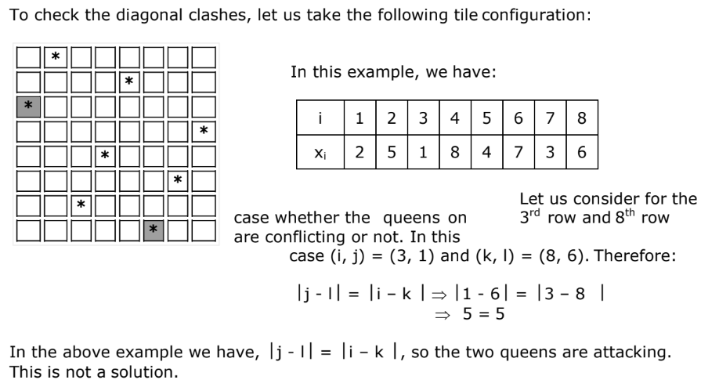

Slide 9
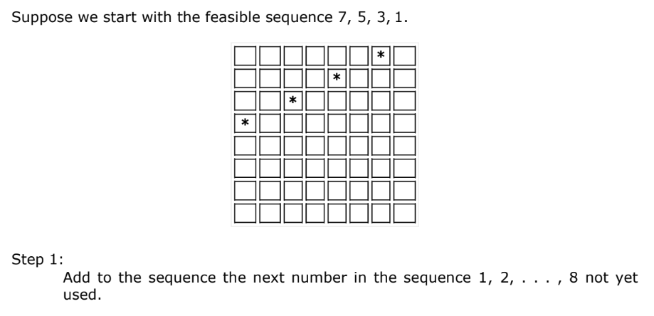

Slide 10
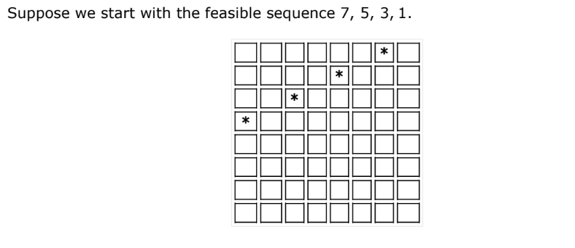

Slide 11
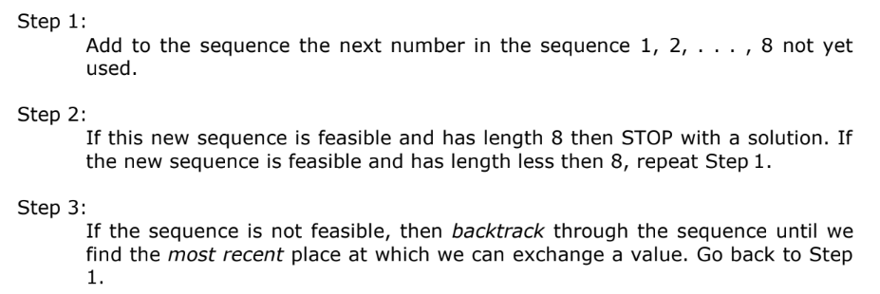

Slide 12
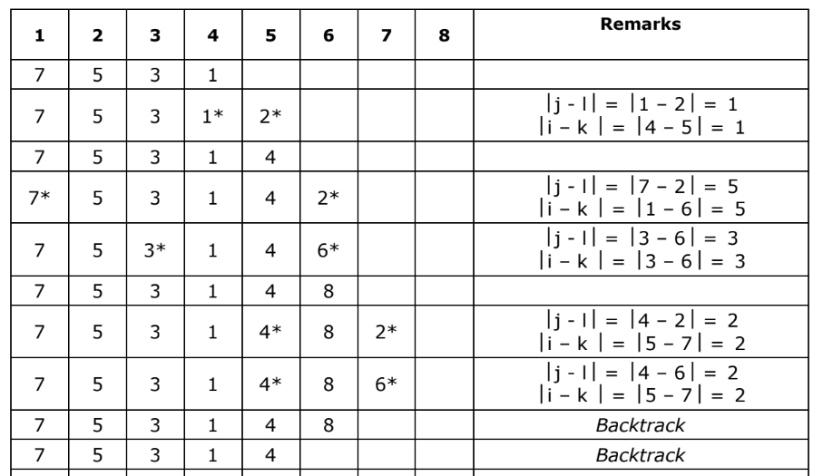

Slide 13
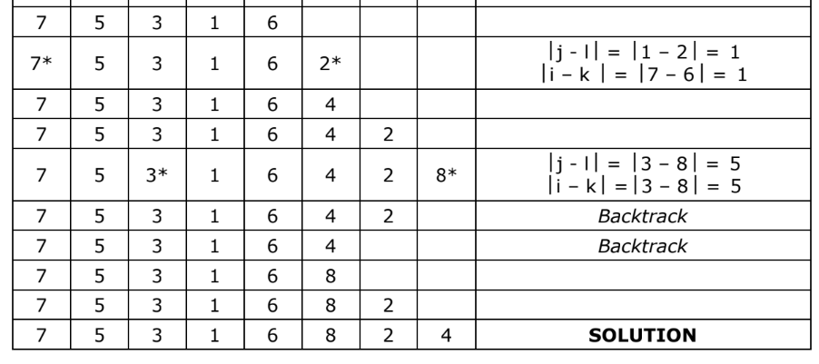

Slide 14
Sum of Sub-set problem
Given a set of non-negative integers and a value sum, the task is to check if there is a subset of the given set whose sum is equal to the given sum.
Examples:
Input: set[] = {3, 34, 4, 12, 5, 2}, sum = 9 Output: True Explanation: There is a subset (4, 5) with sum 9.
Input: set[] = {3, 34, 4, 12, 5, 2}, sum = 30 Output: False Explanation: There is no subset that add up to 30.

Slide 15
Sum of Sub-set problem
Given positive numbers w_{i}, 1 ≤ i ≤ n, and m, this problem requires finding all subsets of w_{i} whose sums are ‘m’.
All solutions are k-tuples, 1 ≤ k ≤ n.
For example, n = 4, w = (11, 13, 24, 7) and m = 31, the desired subsets are (11, 13, 7) and (24, 7).
Draw the tree for the given problem to find the solution.

Slide 16
Graph coloring problem
Let G be a graph and m be a given positive integer.
We want to discover whether the nodes of G can be colored in such a way that no two adjacent nodes have the same color, yet only m colors are used.
This is termed the m-colorabiltiy decision problem.
The m-colorability optimization problem asks for the smallest integer m for which the graph G can be colored.
Given any map, if the regions are to be colored in such a way that no two adjacent regions have the same color, only four colors are needed.
For many years it was known that five colors were sufficient to color any map, but no map that required more than four colors had ever been found.
After several hundred years, this problem was solved by a group of mathematicians with the help of a computer. They showed that in fact four colors are sufficient for planar graphs.

Slide 17
Graph coloring problem
The function m-coloring will begin by first assigning the graph to its adjacency matrix, setting the array x [] to zero.
The colors are represented by the integers 1, 2, . . . , m and the solutions are given by the n-tuple (x1, x2, . . ., xn), where xi is the color of node i.

Slide 18
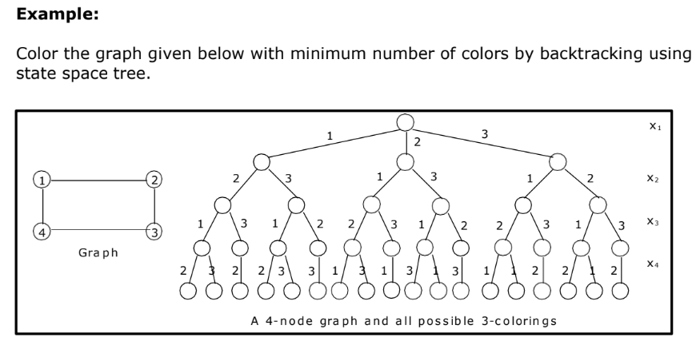

Slide 19
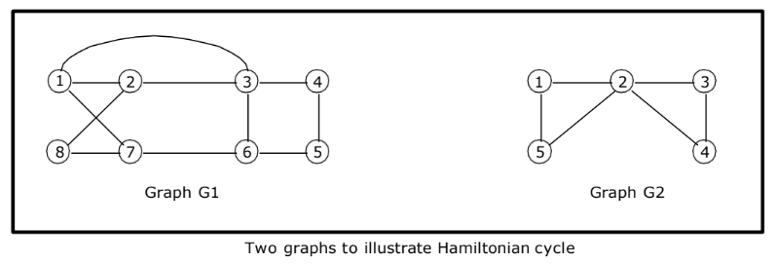
Hamilton Cycle
Let G = (V, E) be a connected graph with n vertices. A Hamiltonian cycle (suggested by William Hamilton) is a round-trip path along n edges of G that visits every vertex once and returns to its starting position.
The graph G1 contains the Hamiltonian cycle 1, 2, 8, 7, 6, 5, 4, 3, 1. The graph G2 contains no Hamiltonian cycle.

Slide 20
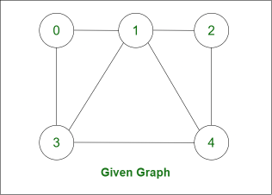
Start with the node 0 .
Apply DFS for finding the Hamiltonian path.
When base case reach (i.e. total no of node traversed == V (total vertex)):
Check whether current node is a neighbour of starting node.
As node 2 and node 0 are not neighbours of each other so return from it.

Slide 21
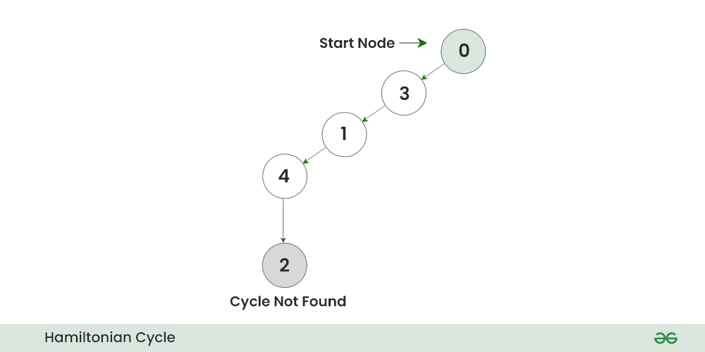

Slide 22
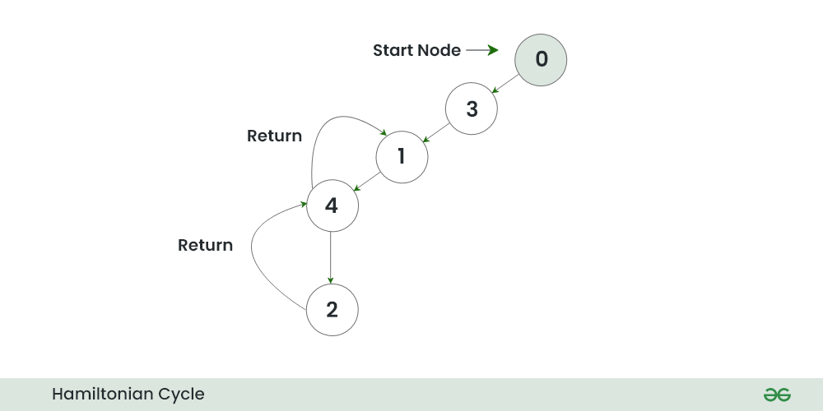
As cycle is not found in path {0, 3, 1, 4, 2}. So, return from node 2, node 4.

Slide 23
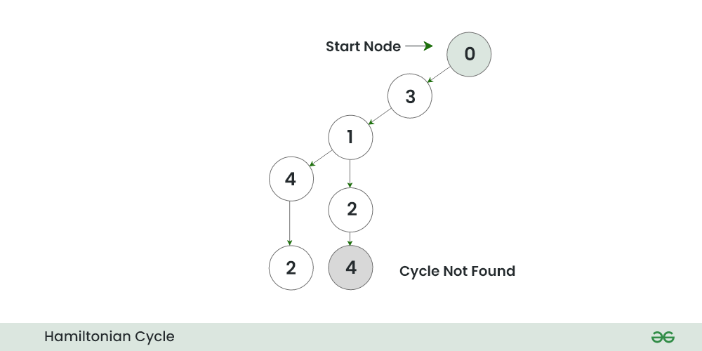
Now, explore another option for node 1 (i.e node 2)
When it hits the base condition again check for Hamiltonian cycle
As node 4 is not the neighbour of node 0, again cycle is not found then return.

Slide 24
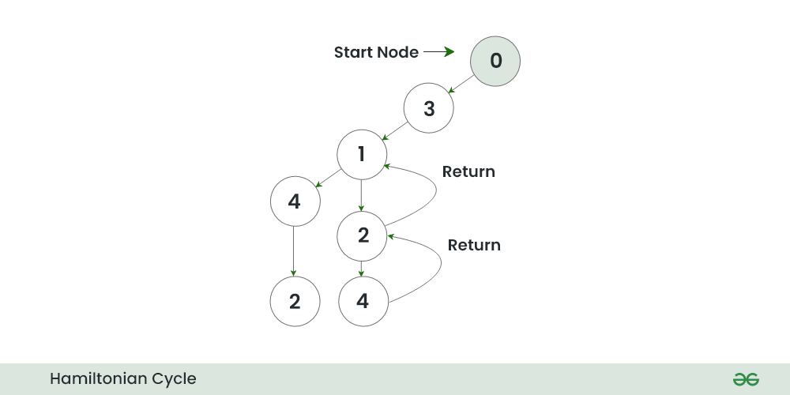
Return from node 4, node 2, node 1. Now, explore other options for node 3.

Slide 25
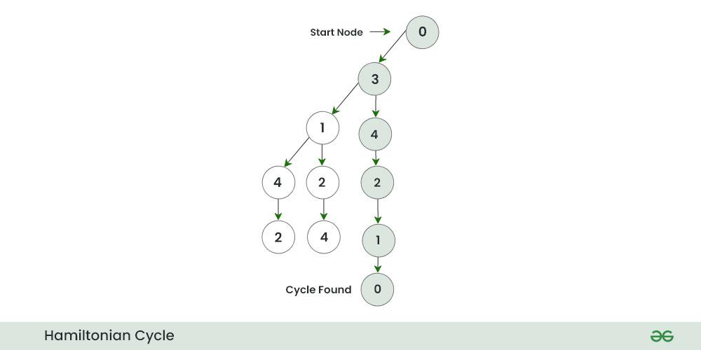
In the Hamiltonian path {0,3,4,2,1,0} we get cycle as node 1 is the neighbour of node 0.
So print this cyclic path .
This is our Hamiltonian cycle.

Slide 26
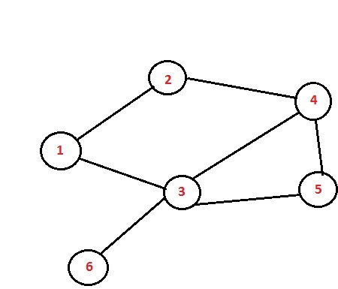
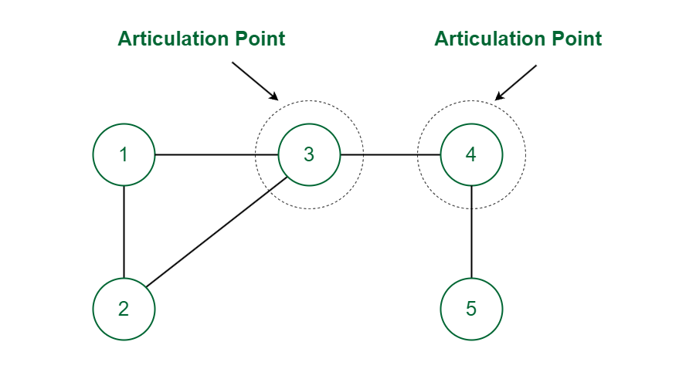
Hamilton Cycle

Slide 27


